Slide 1
Chapter 9: Counters

Slide 2
Chapter Objectives
After studying this chapter, students should be able to:
Understand finite state machines (FSMs) and various types of counters - including asynchronous, synchronous, binary, and decade counters.
Analyze and design counter circuits - including timing diagrams, integrated circuit (IC) counters, and practical applications.
Determine and modify the modulus of a counter - including the use of cascaded counters to achieve higher modulus values.
Generate and analyze counting sequences - such as up/down counting and designing specific state sequences.
Decode counter states and troubleshoot errors - including the use of logic gates for decoding and methods to eliminate glitches in counter outputs.

Slide 3
Chapter Outline
9.1. Finite State Machines 9.2. Asynchronous Counters 9.3. Synchronous Counters 9.4. Up/Down Synchronous Counters 9.5. Design of Synchronous Counters 9.6. Cascaded Counters 9.7. Counter Decoding 9.8. Counter Applications 9.9. Logic Symbols with Dependency Notation
Multiple-choice test and Problems

Slide 4
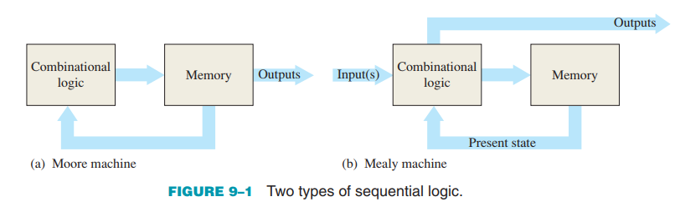
9.1. Finite State Machines
General Models of Finite State Machines (FSMs) consist
Moore Machine: Output depends only on the current state (stored in memory).
Mealy Machine: Output depends on both the current state and the current inputs.
Key Differences
In a Moore machine, output changes only when the state changes.
In a Mealy machine, output can change immediately with input, even if the state hasn't changed.

Slide 5
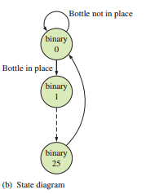
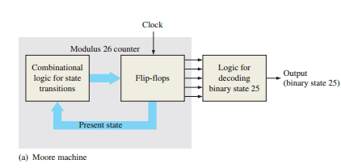

9.1. Finite State Machines
Example – Moore Machine Counter
Design Example
Modulus-25 synchronous binary counter. Counts from 0 to 24, resets to 0 on the 25th clock pulse

Slide 6
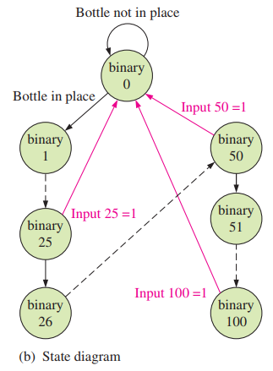
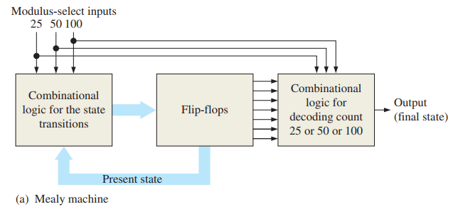

9.1. Finite State Machines
Example of a Mealy Machine
Variable-Modulus Counter:
Used in a tablet-bottling system with 3 bottle sizes: 25-tablet, 50-tablet, and 100-tablet bottles.
Requires a state machine with three terminal counts: 25, 50, 100.

Slide 7
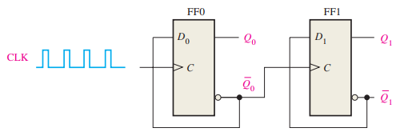
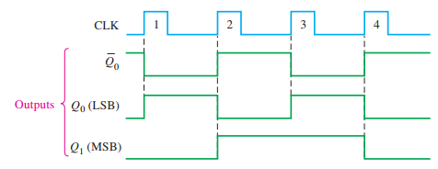
9.2. Asynchronous Counters
A 2-Bit Asynchronous Binary Counter Structure and Operation
Timing Diagram

Slide 8
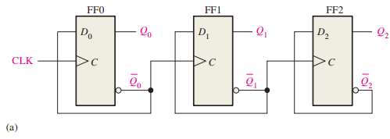
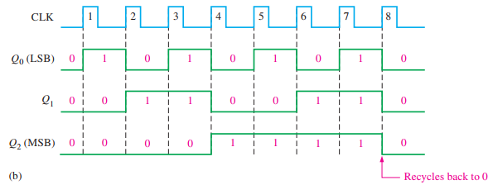
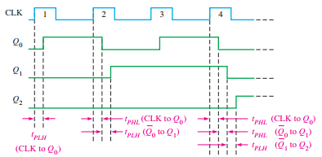
9.2. Asynchronous Counters
A 3-Bit Asynchronous Binary Counter Structure and Operation
Timing Diagram
Propagation Delay

Slide 9
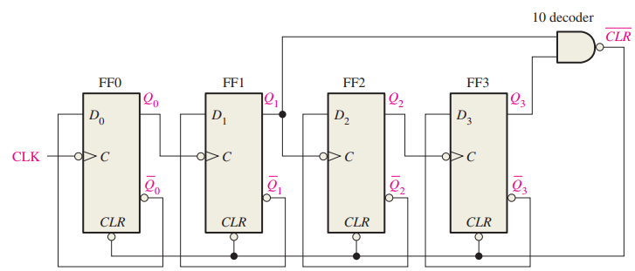
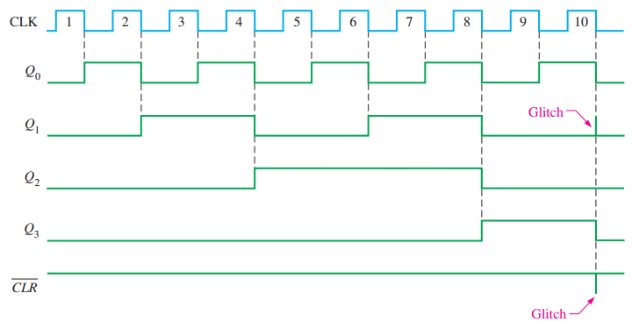
9.2. Asynchronous Counters
Asynchronous Decade Counters & Partial Decoding This technique allows standard binary counters to implement custom counting ranges like 0–9, useful for digital displays and BCD applications.

Slide 10
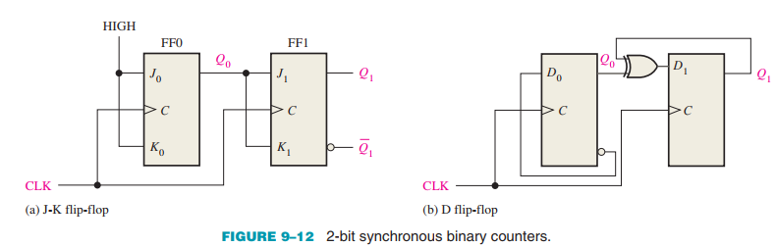
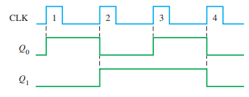
9.3. Synchronous Counters
A 2-Bit Synchronous Binary Counter
Synchronous counters allow faster and more predictable counting compared to asynchronous (ripple) counters, as all flip-flops are triggered by the same clock pulse.

Slide 11
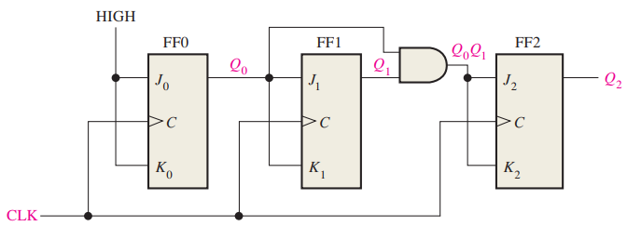
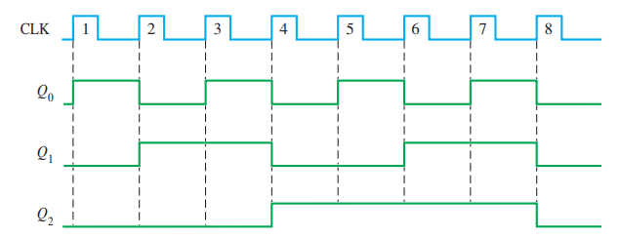
9.3. Synchronous Counters
A 3-Bit Synchronous Binary Counter
The 3-bit synchronous counter ensures accurate operation without the propagation delay found in asynchronous counters, making it ideal for efficient and precise digital circuit design.

Slide 12
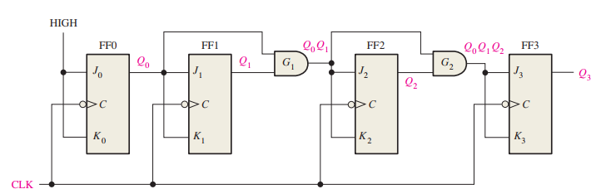
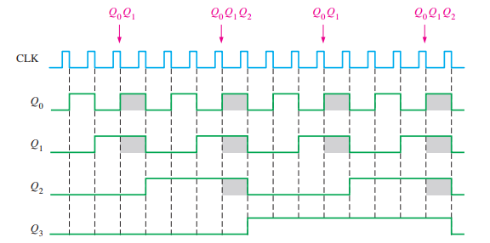
9.3. Synchronous Counters
A 4-Bit Synchronous Binary Counter
The 4-bit synchronous binary counter provides high performance and optimal accuracy in digital circuit design, making it ideal for counting and timing systems.

Slide 13
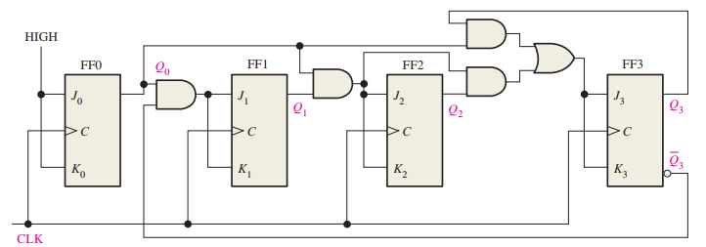
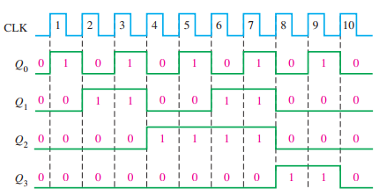
9.3. Synchronous Counters
A 4-Bit Synchronous Decade (BCD) Counter
The synchronous BCD counter operates accurately and quickly, without the propagation delay found in asynchronous counters.
Applications: clocks, decimal digital displays, and counting systems limited to the range 0–9.

Slide 14
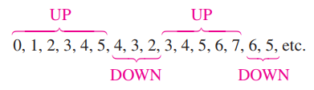
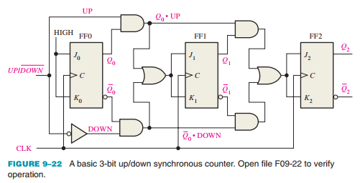
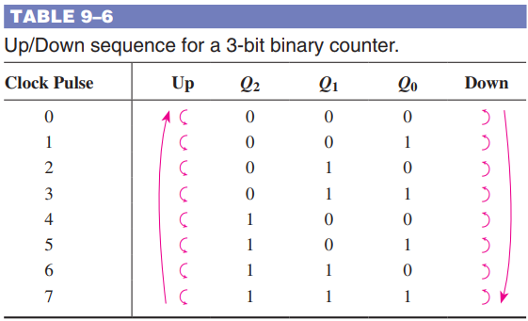
9.4. Up/Down Synchronous Counters
Up/Down Counter – 3-Bit Binary Counter
An Up/Down counter can count in both increasing and decreasing binary sequences. The counting direction can be reversed at any point in the sequence.

Slide 15
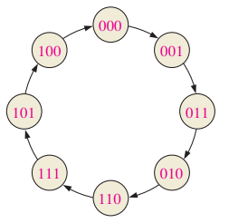
9.5. Design of Synchronous Counters
Step 1: State Diagram A state diagram shows the sequence of states a counter or state machine goes through with each clock pulse. It's the first step in designing any state machine or digital counter.

Slide 16
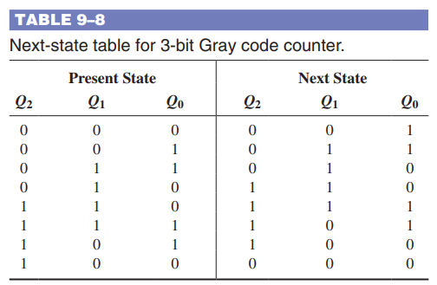
9.5. Design of Synchronous Counters
Step 2: Next-State Table The next state is the state that the counter goes to from its present state upon application of a clock pulse.

Slide 17
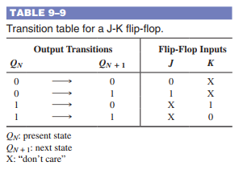
9.5. Design of Synchronous Counters
Step 3: Flip-Flop Transition Table The transition table is an essential tool in the design of synchronous counters, as it helps determine the exact input conditions required to trigger each flip-flop.

Slide 18
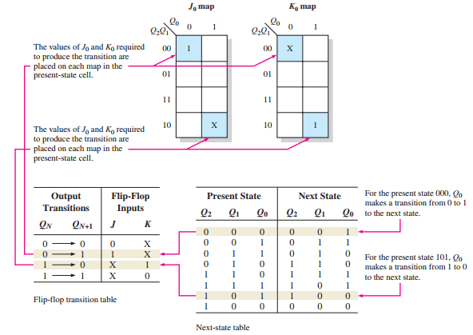
9.5. Design of Synchronous Counters
Step 4: Karnaugh Maps
Karnaugh maps (K-maps) are used to determine the logic expressions for the J and K inputs of each flip-flop in the counter.

Slide 19
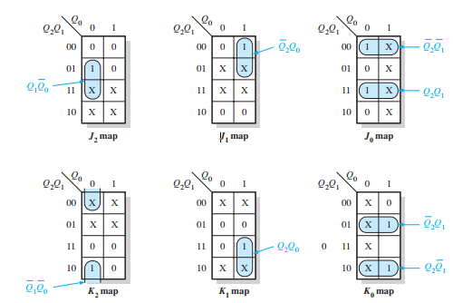
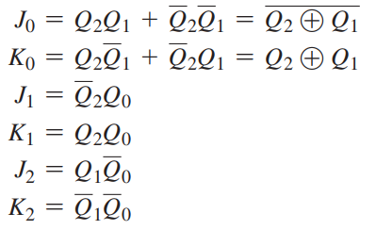
9.5. Design of Synchronous Counters
Step 5: Logic Expressions for Flip-Flop Inputs From the Karnaugh maps, you obtain the following expressions for the J and K inputs of each flip-flop:

Slide 20
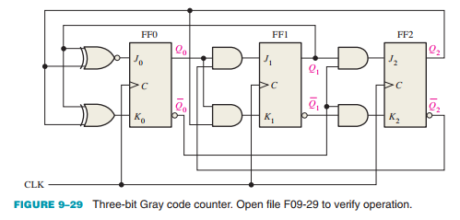
9.5. Design of Synchronous Counters
Step 6: Counter Implementation The final step is to implement the combinational logic from the expressions for the J and K inputs and connect the flip-flops to form the complete 3-bit Gray code counter as shown in Figure 9–29.

Slide 21
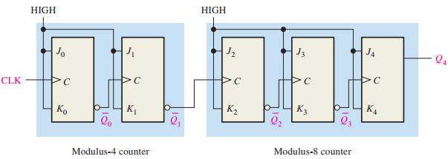
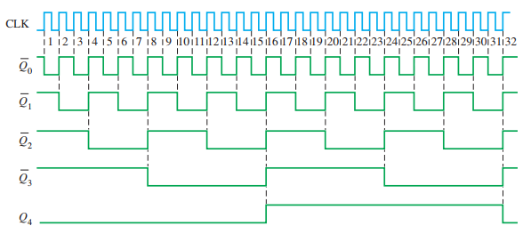
9.6. Cascaded Counters
Asynchronous Cascading Asynchronous cascading is a simple and effective way to increase counting range, though it introduces cumulative propagation delay.

Slide 22
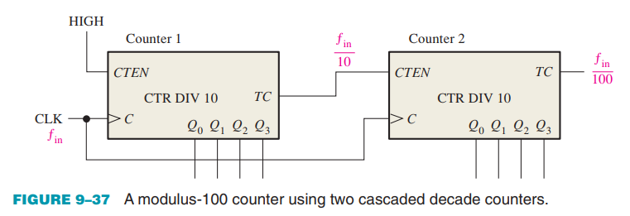
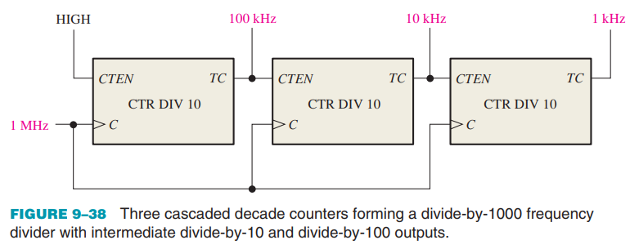
9.6. Cascaded Counters
Synchronous Cascading Achieve higher-modulus operation by cascading synchronous counters using count enable (CTEN) and terminal count (TC) functions.

Slide 23
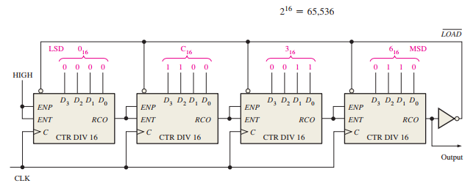

9.6. Cascaded Counters
Cascaded Counters with Truncated Sequences By using synchronous loading, a cascaded counter with a truncated sequence can accurately achieve any desired divide-by modulus

Slide 24
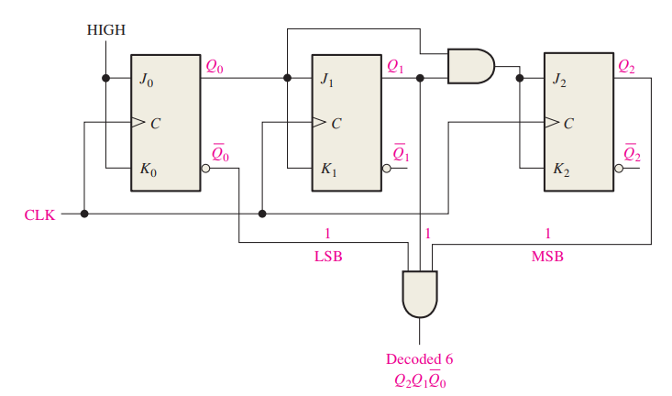
9.7. Counter Decoding
State Decoding in a 3-Bit Binary Counter State decoding is useful in applications such as event triggering, pulse generation, or activating outputs at specific count values.

Slide 25
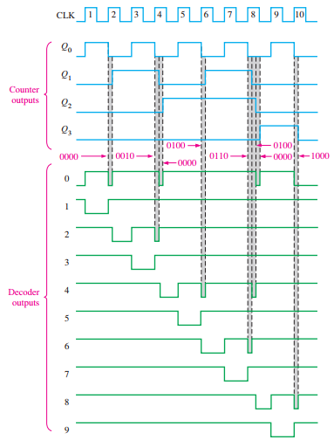
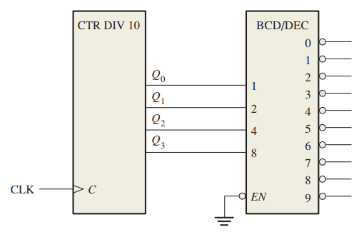

9.7. Counter Decoding
Decoding Glitches Glitches can impact circuit performance and must be considered in high-speed or precision digital designs.

Slide 26
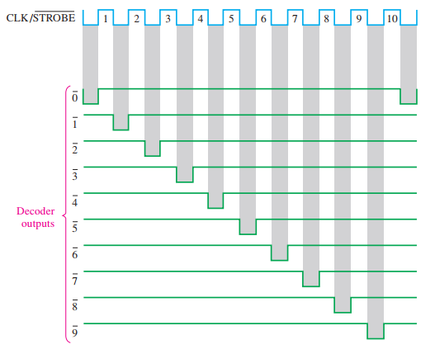
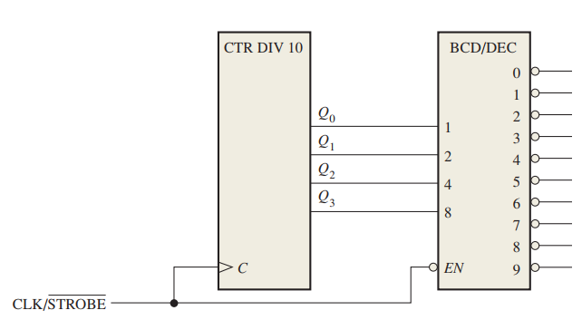
9.7. Counter Decoding
Cascaded Counters with Truncated Sequences Glitches can impact circuit performance and must be considered in high-speed or precision digital designs.

Slide 27
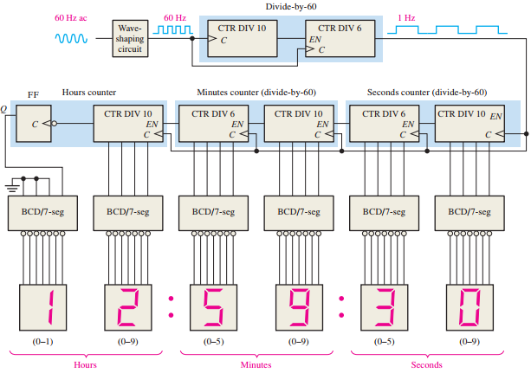
9.8. Counter Applications
A Digital Clock

Slide 28
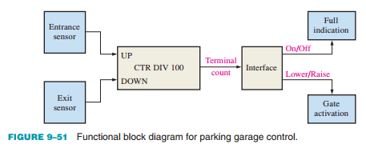
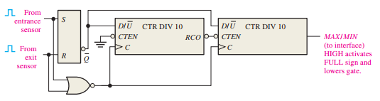
9.8. Counter Applications
Automobile Parking Control

Slide 29
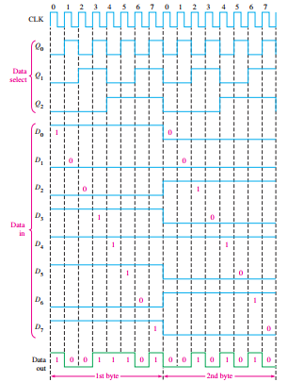
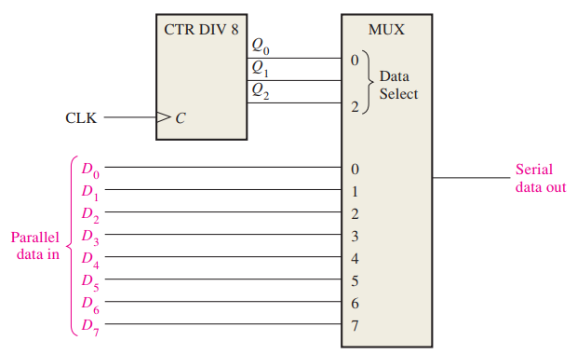
9.8. Counter Applications
Parallel-to-Serial Data Conversion (Multiplexing)

Slide 30
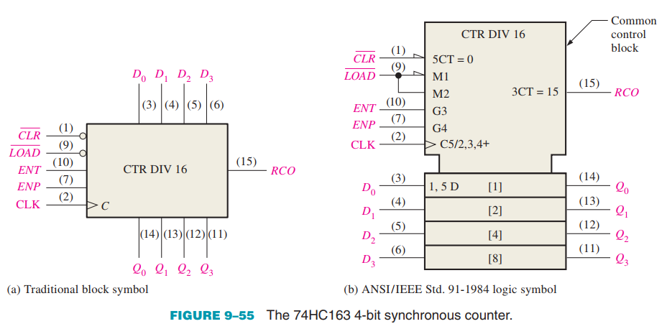
9.9. Logic Symbols with Dependency Notation
Qualifying Symbol The label “CTR DIV 16” in Figure 9–55(b) identifies the device as a counter (CTR) with sixteen states (DIV 16).

Slide 31
SUMMARY
Chapter 9: Counters
Synchronous vs. Asynchronous Counters:
Asynchronous counters: each stage is triggered by the output of the previous stage.
Synchronous counters: all stages are triggered by the same clock pulse → faster operation.
Maximum Modulus:
The maximum number of states is given by:
Maximum modulus = 2n
where n is the number of flip-flops. The actual modulus can be equal to or less than this maximum value.
Cascaded Counters Modulus:
The overall modulus equals the product of the moduli of individual counters.

Slide 32
MULTIPLE-CHOICE TEST AND PROBLEMS
Complete the true/false questions, multiple-choice questions, and end-of-chapter exercises in the primary textbook.

